Slide 1
My tree is the tree I’m looking for, help!
Non tree like evolution part 1

Slide 2
Phylogenetic tree denote approximate the transmission history

Slide 3
Processes, such as co-infection can lead to a person carrying pathogens from more than one source

Slide 4
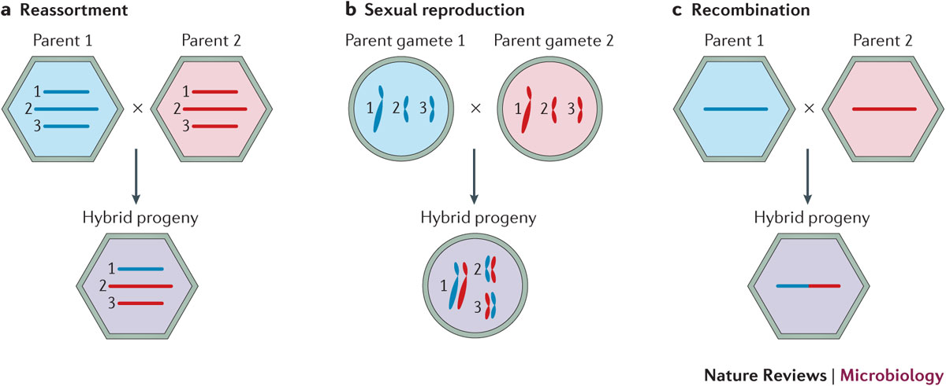
Different processes to “mix” genetic materials from two parent lineages exist

Slide 5
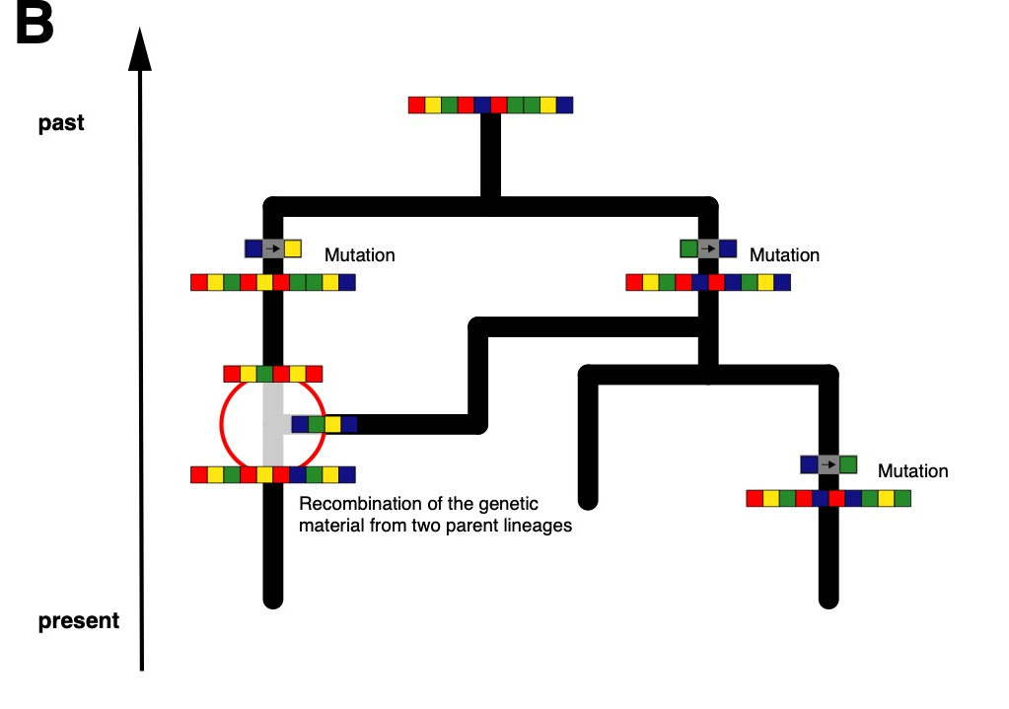
The combined genetic material may represent a network and not a tree

Slide 6
Genetic recombination processes lead to different parts of a genome coding for different histories

Slide 7
Ways to deal with recombination
Only use small parts of the genome that code for the same tree (e.g. only use one segment of influenza).
Consider different parts of a genome to be independent (Bad if they are not).
Just ignore recombination (bad if there is).
Infer networks instead of trees. (Best case, but potentially slow)

Slide 8
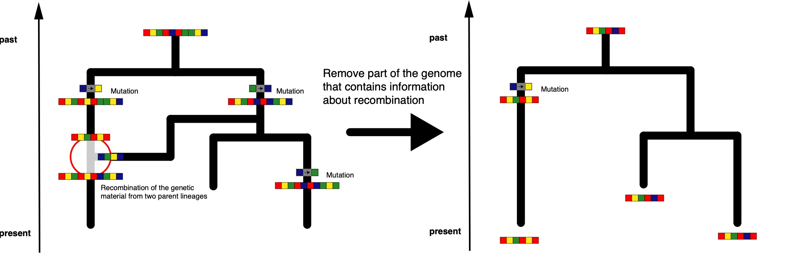
Only use small parts of the genome that code for the same tree.

Slide 9
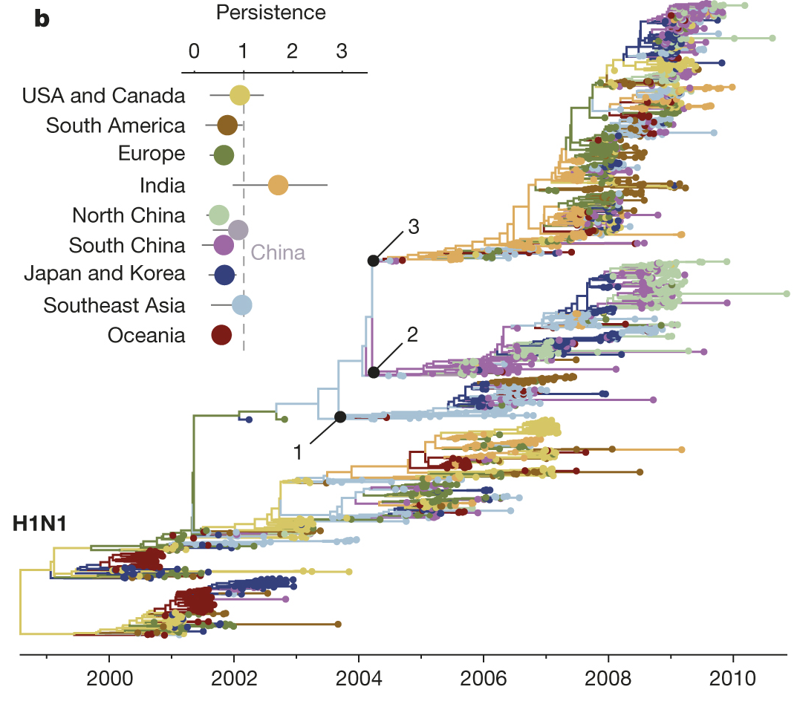
Population dynamics can be inferred from individual influenza segments
Bedford et al., 2015, Nature

Slide 10
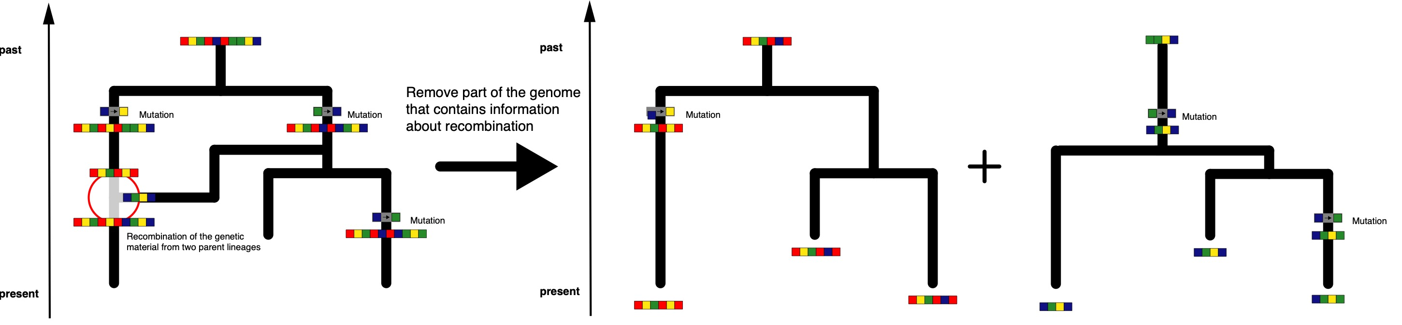
Consider different parts of a genome to be independent. (Sometimes correct)

Slide 11
Species tree inferences typically assume individual parts of the genome to be independent observations of a speciation process

Slide 12
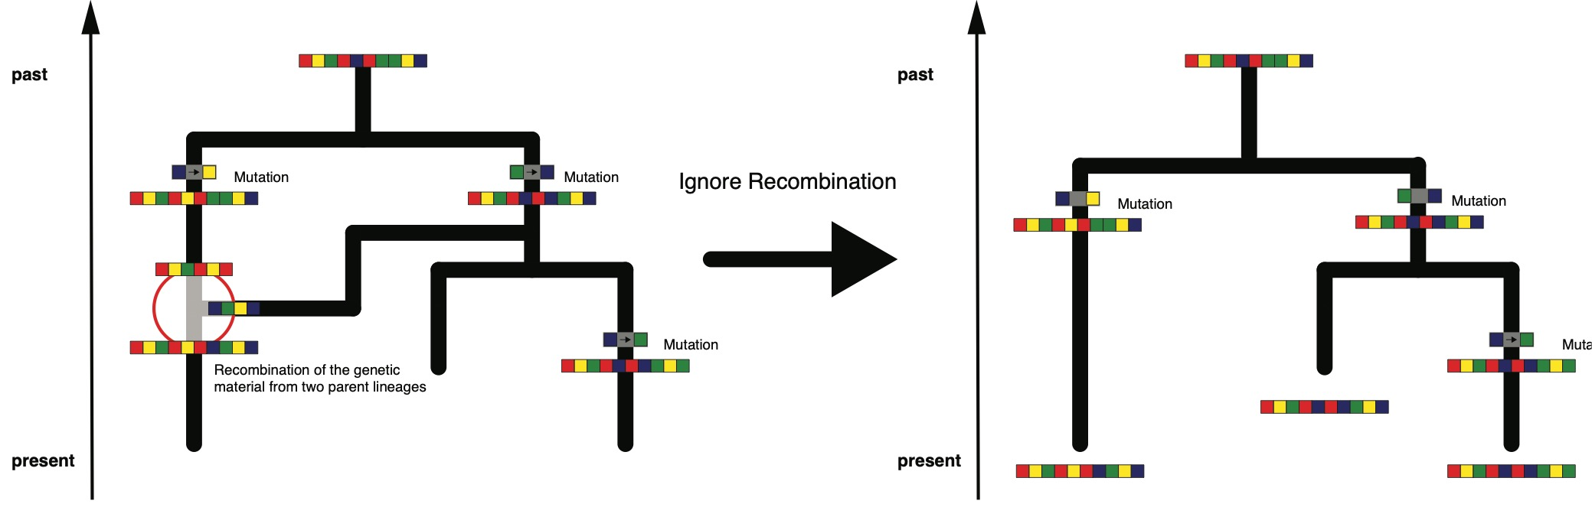
Just ignore recombination. (Always wrong)

Slide 13
QUESTIONS?

Slide 14
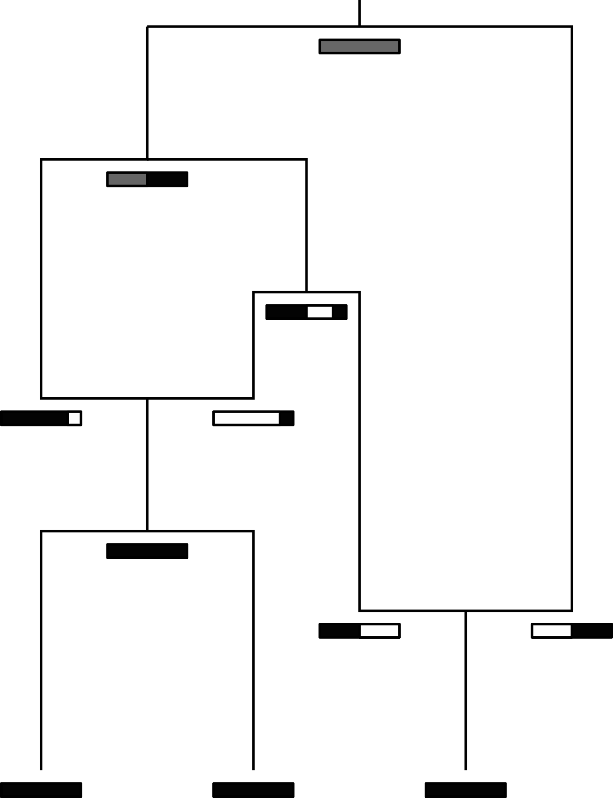
The coalescent with gene conversion models how lineages coalesce (Wiuf and Hein, 2000)
Coalescent rate is given by 1/Ne
Recombination rate is r
Recombination breakpoints uniformly chosen across alignment
Slide from Tim Vaughan

Slide 15
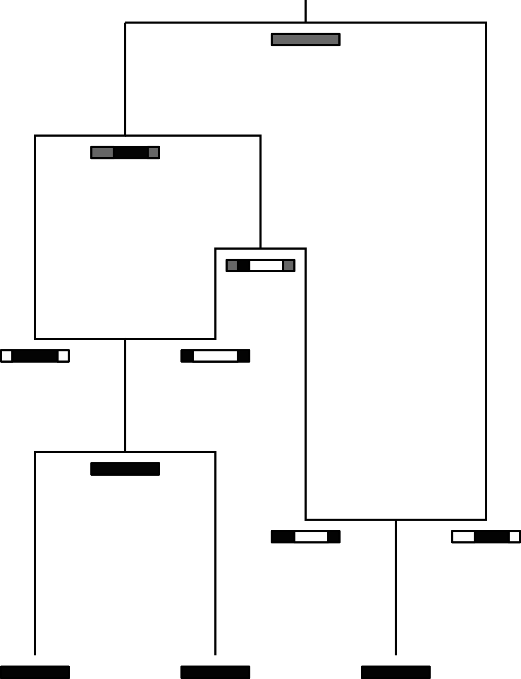
The coalescent with gene conversion models how lineages coalesce (Wiuf and Hein, 2000)
Coalescent rate is given by 1/Ne
Gene conversion rate is r
Gene conversion happens at random site and for elements of random length
Slide from Tim Vaughan

Slide 16
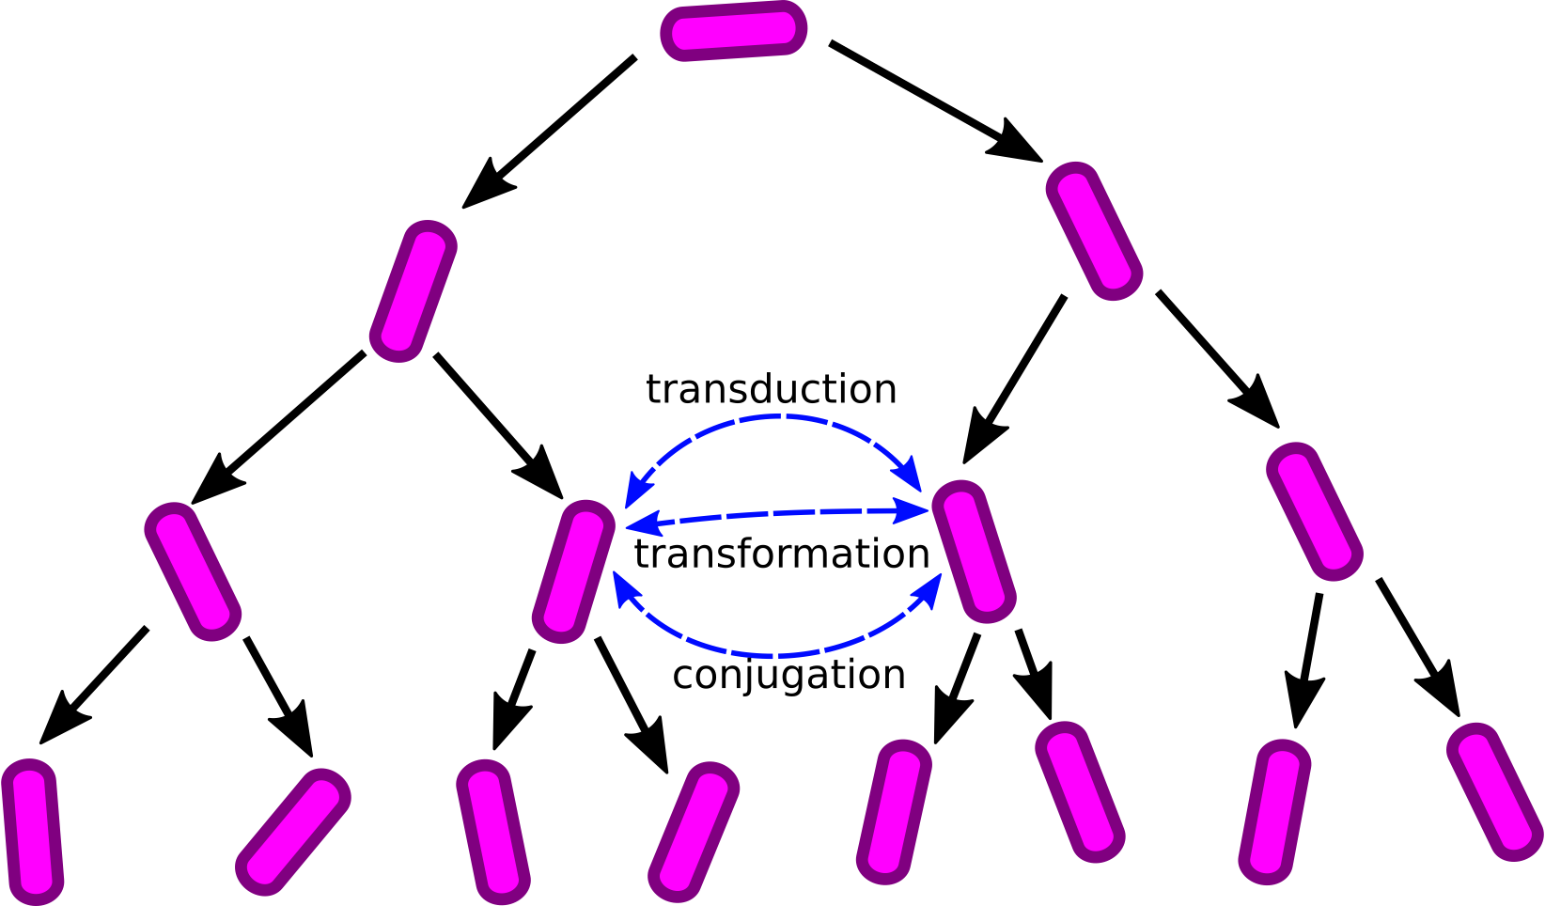
The coalescent with gene conversion can be use to model the exchange of genetic material between bacteria
Slide from Tim Vaughan

Slide 17
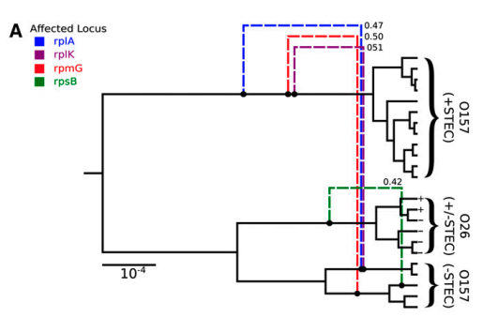
Ancestral recombination graphs for the coalescent with gene conversion can be inferred in BEAST2 using Bacter
Allows to estimate tree based networks that have a base tree and edges that detach and re-attach directly to that base tree
Requires the assumption that only a small part of the genome is subject to recombination

Slide 18
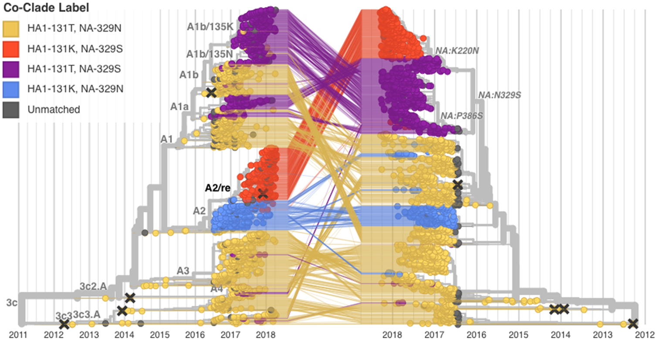
Segmented viruses can rassort, leading different segments to code for different trees
Potter et al. (2019), Virus Evol.

Slide 19
The coalescent with reassortment allows to model a joint coalescent and reassortment process
Müller et al. (2020), PNAS

Slide 20
CoalRe allows inferring reassortment networks, reassortment rates etc. jointly
Müller et al. (2020), PNAS

Slide 21
Correctly modelling the reassortment process impact precision and reduces bias
Müller et al. (2020), PNAS

Slide 22
QUESTIONS?

Slide 23
Some reading material
Coalescent with recombination: https://doi.org/10.1016/0040-5809(83)90013-8
Coalescent with gene conversion: https://www.genetics.org/content/155/1/451.short
ARG’s for bacteria: https://www.genetics.org/content/205/2/857
Coalescent with reassortment: https://www.pnas.org/content/early/2020/07/02/1918304117

